Slide 1
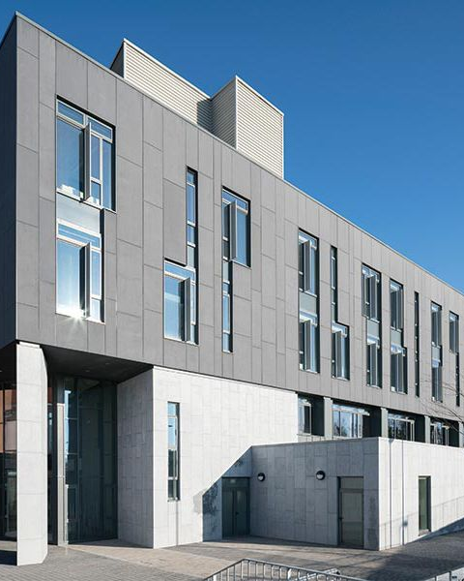
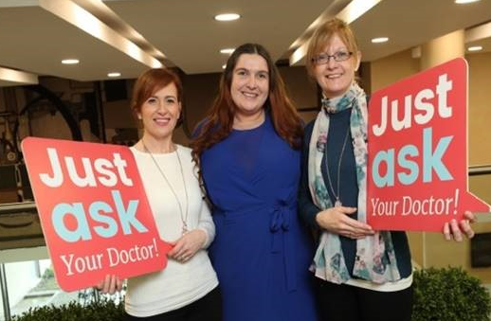
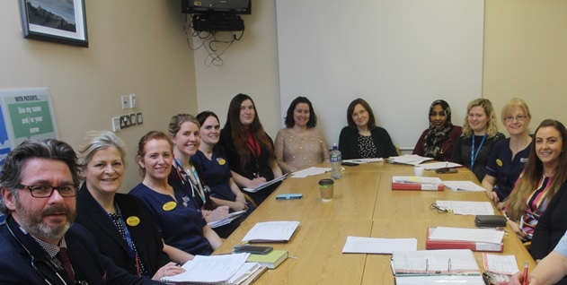
LIMERICK CANCER TRIALS
Demographic
Population c. 420,000
Rural, Older
Social Deprivation (24%)
Cancer Care
Six Hospitals in Mid West
Cancer services centralised in UHL
>2,500 new cases annually
Cancer Trials Unit
64 Studies since 2018
1195 Patients Recruited
Top Recruiter 2018 & 2023
Academic partner
University of Limerick
Limerick Digital Research Centre
Research Centre on UHL campus

Slide 2
MISSION STATEMENT
VISION
MISSION
To deliver an innovative portfolio of multidisciplinary clinical trials to positively impact health outcomes for all patients affected by cancer in our region.
To focus on strong patient partnerships, impactful national and internationals collaborations and excellence in training and education to advance cancer care and research.
CORE VALUES
01
02
03
04
05
Innovative Research
Patient- Centred Care
Excellence & Integrity
Collaboration
Transparency

Slide 3
STRATEGY
Clinical-Academic Research Strategy
Patient – partnered through PPI collaboration
Cancer Inequalities
& Social Deprivation
Big Cancers & Haematology
Integrated Care & Survivorship
Digital Innovations & Partnerships
Education
&
Training
THE TEAM
Prof Ruth Clifford
Haematologist
Director LCTG
Dr Greg Korpanty
Medical Oncologist
Clinical Director
Dr Niamh Peters
Medical Oncologist
Co-Director LCTG
Prof Christina Fleming
Colorectal Surgeon
Acting Co-Director LCTG
Prof Aedín Culhane
Cancer Genomics
Director LDCRC
Prof Alan Donnelly
Exercise Physiology
Director HRI
Prof Rose Galvin
Physiotherapist
Director ARC
Dr Patrick O’Donnell
General Practitioner
Social Inclusion

Slide 4
TRIAL EVOLUTION
INCLUSIVITY
DIGITAL TECHNOLOGY
Large rural area
Deprivation
Marginalised groups
Data digitization
Genomics infrastructure
eHealth Hub
Patient Population
Local Expertise
Resources
Future Proofing
AGING POPULATION
REAL WORLD EVIDENCE
Underrepresented
QoL & Survivorship
Aging Research Centre (ARC)
Diverse populations
Broader evidence base
International cohort studies

Slide 5
Disease Focus Areas
01
02
03
04
05
BREAST
LUNG
PROSTATE
COLORECTAL
BLOOD
Dr Greg Korpanty
Breast/Lung
Dr Greg Korpanty
Dr Niamh Peters
Dr Umair Aleem
Prof Christina Fleming
Prof Ruth Clifford

Slide 6
SUBGROUPS
PPI
BLOOD
Clinical: Mr John Lawler
Academic: Dr Miriam McCarthy
Clinical: Prof Ruth Clifford
Academic: Dr Elizabeth Ryan
ALLIED HEALTH
BREAST
Clinical: Prof Rose Galvin
Academic: Dr Sarah Dillon
Clinical: Dr Chwanrow Baban
Academic: James Brown
Clinical-Academic
Groups Meet Monthly
Quarterly Cancer Research Symposium
Alternate sites
CANCER NURSING
COLORECTAL
Clinical: Ms Nichola McNamara
Academic: Prof Pauline Meskell
Clinical: Prof Christina Fleming
Academic: Dr Kieran McGourty
BIOBANKING
GU/PROSTATE
Clinical: Prof Ruth Clifford
Academic: Dr Elizabeth Ryan
Clinical: Dr Niamh Peters
Academic: Prof Eoghan Cunnane

